Slide 1
State Legislative and Budget Update
Paul J. Yoder and Karen Lange
June 14, 2012

Slide 2
2012 CACTTC Legislation

Slide 3
AB 2643 (Ma)
Clarifies taxes due must be paid pending a reassessment.
Gives 90 days to calculate pool rate.
Allows duplicate payments to be applied to delinquent payments on the same property.
More amendments possible in the Senate.
Bill has been approved unanimously thus far.

Slide 4
AB 1045 (Norby)
Bans pay-for-play in California school bond elections.
Currently in Senate Governance and Finance Committee after failing passage by 2 votes.
Author’s office has requested the FPPC review the current practices to determine if there is a remedy aside from legislation.

Slide 5
AB 1957 (Gordon)
Bill contained provisions to authorize shortening notifications required in newspapers.
Authorized CEUs in Tax Collections.
Bill heavily opposed by CNPA.
Failed passage in Assembly Local Government.

Slide 6
Mobile Home Information
Platform contained a proposal to compel HCD to provide information to TTCs on mobile homes.
HCD agreed to provide the information without legislation.
Interested TTCs are received bi-weekly updates from HCD.

Slide 7
Bills of Interest to CACTTC

Slide 8
AB 2210 (Smyth)
Requires a county assessor, when requested by the board of supervisors, to estimate whether annual property valuations for the county have decreased by 3% or more, and if so, to notify the county and the Department of Finance of the decrease.
Initially the bill included TTCs in the estimate process but that provision was dropped at our request.
Bill passed Assembly unanimously and is to the Senate.

Slide 9
AB 2299 (Feuer)
Authorizes the board of supervisors to establish a program to redact (upon request) public safety officials’ names from property records disclosed to the public.
Bill is strongly opposed by Clerk-Recorders Association.
CACTTC has sent a letter of concerns.
Bill was heard yesterday in Senate Governance and Finance and was held. CACTTC concerns were mentioned as a reason the majority would not vote for the measure.

Slide 10
AB 1181 (Butler)
Re-establishes PTAP program for 2012-13 through 2015-16.
Would also require the California Assessors' Association to report on participation.
CACTTC has historically asked that the bill specify that TTCs are allotted funding proportional to the workload share.
The bill currently only directs that Assessors consult with TTCs.
No hearing date set yet.

Slide 11
State Budget Trailer Bill Language
Would authorize a County Treasurer to loan funds to charter schools.
Initial language was mandatory. Revised language is permissive to a Board of Supervisors.
CACTTC is opposed, along with CSAC, Orange County.
Senate Budget Chair rejected language late Tuesday afternoon. Assembly had accepted permissive language. Final budget language not currently in print.

Slide 12
Looking Ahead to 2013 Legislation
CAB Legislation with Sen. Wyland
Potentially jointly sponsoring legislation on Assessed Valuation calculations for Prop. 39 elections with HJTA, CalTax and CalBOC.
2013 Platform – process begins in July 2012.

Slide 13
2012-13 State budget

Slide 14
2012-13 Budget
Required to be passed by the Legislature no later than tomorrow (June 15), or Legislators forego their pay.
Per recent Court decision, the Legislature is the arbiter of whether or not the budget is balanced (not the State Controller).

Slide 15
Budget - Continued
$15.7 billion estimated deficit to resolve mainly through cuts, trigger cuts, the proposed tax increase.
Locks in three more years of realignment funding formulas for Counties.
Budget includes $2.1 billion repayment of funds borrowed pursuant to Proposition 1A three years ago.

Slide 16
Budget - Continued
Relies heavily on the Governor’s tax initiative being approved by the voters in November (generating between $7 and 9 billion.)
Absent approval, $6.1 billion in trigger cuts will occur.

Slide 17
Addressing the Shortfall
The Governor’s plan to close $15.7 billion gap between revenues and expenditures is:
1) Revenues initiative = $5.5b in year one
2) Cuts: $8.3 billion in total spending reductions
  Approx. $2.3b to education
  Approx. $2.5b to health and human services
  Approx. $3.5b sweeping RDA, mandate cut, trial courts and employee compensation changes
  3)Other shifts, transfers: $2.8 b

Slide 18
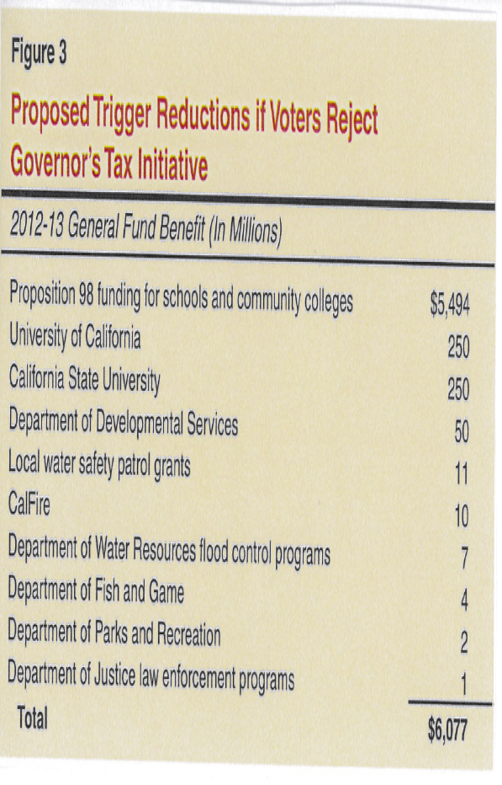
Budget – Trigger cuts

Slide 19
Budget - Continued
The Budget counted on $35/share for Facebook stock to generate between $1 and $2 billion; closes at $25.87 on 6/5/12. (Google resulted in $7 billion over three years to California) – trading at $27 this morning.
Sweeps remaining housing funds leftover from RDA elimination ($1.4 billion) into General Fund.
Sweeps $400 m in national mortgage settlement into GF.

Slide 20
State revenue trend
The State ended last fiscal year with a cash deficit of $8.2 billion.
The combined current-year cash deficit stands at $17 billion.
Those deficits are being covered with $11.1 billion of internal borrowing (temporary loans from special funds) and $5.9 billion of external borrowing.

Slide 21
State revenues – may 2012
May cash receipts were slightly above projections ($83.5 million above or 1.3 percent%) due to higher than expected insurance revenues.
Revenues from the “Big 3” sources of revenue—personal income taxes, sales taxes, and corporate taxes—came in 2.0% below estimates.
This is important be-cause these three taxes form the lion’s share of General Fund revenues, representing roughly 90% of total revenues each year.

Slide 22
RDA Pass-through at risk
Legislative leaders proposed their own budget on Wednesday.
It assumes suspension of negotiated pass through agreements cities, counties, schools and special districts may have with local redevelopment agencies.
Scored $250 million increase in property taxes available to schools as a result of suspending these pass through agreements, lowering the state’s general fund obligation under Proposition 98.
Those savings are then diverted to restore cuts in programs proposed by the Governor.
CSAC has already responded to leadership with a strong oppose position and encourages county leaders to alert their legislators.

Slide 23
RDA Pass Through
The approach would be to nullify pass through agreements which would result in the property taxes dedicated to those pass through agreements being distributed by the existing AB 8 formula in each county.
There are roughly $450 million in pass through revenues. By distributing those revenues through AB 8, schools would get roughly 56% or $250 million in property taxes. This offsets an equal amount the state must make up to schools via Prop 98 and thus frees up that $250 million in state money to fund something else, like child care or CalWORKS.

Slide 24
Pension reform
Pension reform package expected to move through Legislature before the end of the legislative year.
Conference Committee has been meeting throughout the year.
Not expected to require voter approval, but is a possibility.
May include a “cash balance plan”

Slide 25
November 2012
If voters approve both tax proposals, the one receiving the highest number of votes will prevail.
If they approve neither, schools will be scrambling to address major mid-year funding gaps.
Current legislative office holders are not eligible to utilize the term limits extension approved last week.

Slide 26
Questions

